Slide 1

SLOPE OF POPULATION REGRESSION LINE
MADHUMITHA . S
19PW13

Slide 2
Difference between true regression equation and the one estimated from the sample
The regression line is derived from the sample and not from the entire population.As a result,we don’t expect the true regression line equation -> Y = A+ BX (true regression line) to be same as the equation estimated from the sample observations ( y = a+ bx)
Thus,we use the value of b to test hypothesis about the value of B

Slide 3
Testing a hypothesis about B

Slide 4
Annual expenditure problem
Year (n=6) | Expenditure | Annual profit | XY | X²
1995 | 5 | 31 | 155 | 25
1994 | 11 | 40 | 440 | 121
1993 | 4 | 30 | 120 | 16
1992 | 5 | 34 | 170 | 25
1991 | 3 | 25 | 75 | 9
1990 | 2 | 20 | 40 | 4
∑x=30
∑y=180
∑xy=1000
∑x²=200
(∑x)/n = 5
(∑y)/n = 30

Slide 5
Calculating intercept and slope of the regression line
b = ∑xy – x * (∑x /n)(∑y /n)
∑x² - n*(∑x /n)²
^{= 1000 – 900}
^{200 – 150}
^{= 100/50 = 2}
a= ∑y /n-b* ∑x /n = 30 – 10 =20
^{Thus,Ỹ = a + bx = 20 + 2x}

Slide 6
Testing of hypothesis about B
To understand this process, return to the problem that related annual expenditures for research and development to profits.
We pointed out that b=2.the first step is to find some value for B to compare with b=2.
Hypothesis:
Suppose that over extended past period of time the slope of relationship between x and y was 2.1,to test whether this is still the case we could define the hypothesis as
H0 : B = 2.1
H1 : B ≠ 2.1

Slide 7
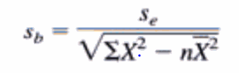
Standard error of the regression coefficient
In effect,we are testing to learn whether current data indicate that b has changed from historical value of 2.1. To find the tests statistic for B its necessary to find the standard error of the regression coefficient
Here,the regression coefficient we are working with is b,the standard error of this coefficient is denoted S(e)
Standard error of b
Where
s(b)=standard error of regression coefficient
S(e)=standard error of the estimate
X=values of independent variable
N=no of data points

Slide 8
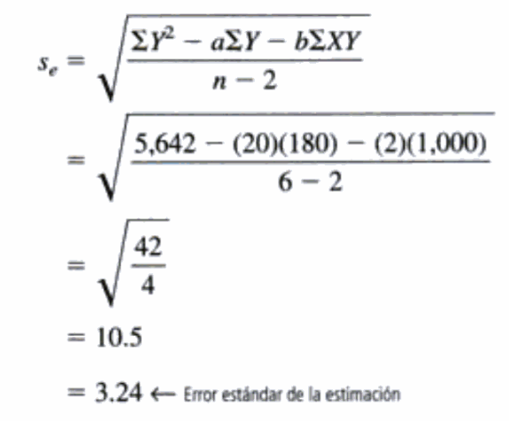
Calculating s(e)

Slide 9
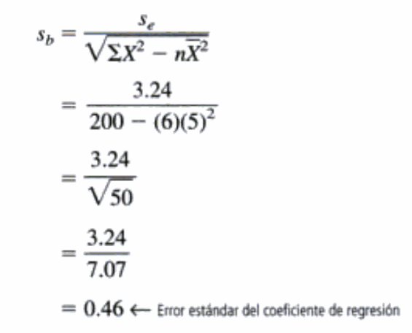
_{Calculating s(b)}

Slide 10
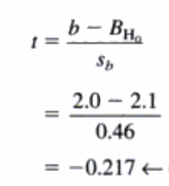
Standardizing the regression coefficient
Where
b = slope of the fitted regression line
B _{H0} = actual slope hypothesised for the population
s_{b} = standard error of regression coefficient

Slide 11
Conducting the hypothesis test
Suppose we have a reason to conduct the test for hypothesis at a 10% level of significance .because we have 6 observations in our sample data,we know that we have n-2 =4 degrees of freedom,
From the t table we see that the appropriate t value is 2.132
We are concerned whether b(the slope of sample regression line) is significantly different from B(the hypothesised slope of the population regression line). Thus, this is a two tailed test and the critical values are (-2.132,2.132)
The standardized regression coefficient is -0.217 ,which is inside the acceptance region for our hypothesis test
Therefore,we accept the null hypothesis B=2.1
Conclusion:
Thus there is not enough difference between b and 2.1 for us to conclude that B has changed from its historical value,because of this we feel that each additional million dollar spent on RND still increases annual profits by about 2.1 million dollars as it has in the past.

Slide 12
Confidence interval of B
In the same way that b is a point estimate of B,such confidence intervals are interval estimates of B.
Assuming we know values of b , s(b) , t
confidence interval = ( b + t *s_{b} , b - t *s_{b} )
b + t(s_{b}) = 2 + 2.132*0.46
= 2.981 - upper limit
b - t(s_{b}) = 2 - 2.132*0.46
= 1.019 - lower limit

Slide 13
Interpreting the confidence interval
In the situation we are 90% confident that the true value of B lies between 1.019 and 2.981 that is ,each additional million dollar spent on research and development increases annual profits by some amount between 1.02 million and 2.98 million dollars.

